Slide 1
Trip Table Estimation and Prediction for Dynamic Traffic Assignment Applications
Sajjad Shafiei^{*1}, Adriana-Simona Mihăiţă^{1,2}, Chen Cai¹
¹Advanced Data Analytics in Transport, DATA61|CSIRO, Sydney, Australia
²University of Technology, Sydney, Australia
*sajjad.shafiei@data61.csiro.au

Slide 2
Outline
Introduction
Dynamic Traffic Assignment (DTA)
Pros and cons for DTA models
Time-dependent Origin-Destination Demand (TDOD)
Methodology
TDOD demand estimation problem
TDOD demand prediction problem
Results
Case study: Victoria Rd Corridor Model
Incident Management Application
Conclusion

Slide 3
Introduction: DTA
Traffic forecasting is a necessary step for efficient network operation and is an integral part of intelligent transportation systems (ITS) applications.
In the transport domain, dynamic traffic assignment (DTA) models are known as a reliable tool to replicate complex traffic conditions.
These models are mainly built based on game theory principles. Each traveller attempts to minimize his/her travel cost (time) while their decision impacts the traffic condition other traveller’s decisions to move in the network.

Slide 4
Introduction: DTA - pros and cons
Advantages:
The intricate traveller route decision can be modelled in the network.
User Equilibrium
Stochastic route choice ( e.g. Logit based models)
They represent the complicated interaction between users and the network (travellers and roads)
Disadvantages:
Site-specific models
Computationally intensive
Various supply and calibration parameters need to be calibrated

Slide 5
Time-Dependent Origin-Destination (TDOD) Demand
The most crucial input for any DTA models is the origin-destination (OD) trip table.
The success of the DTA application relies on the quality of OD demand matrices.
Estimating the OD demand by using link traffic data is a popular approach and far superior to doing the conventional travel surveys which are slow and expensive.
Many studies proposed a bi-level optimization formulation where the feedback of demand changes is evaluated by an assignment model iteratively .

Slide 6
TDOD Demand Estimation Problem
We express the problem mathematically as follows:
$$min ω.{ \sum_{i∈I}{\sum_{t=1}^{T}{{(x_{i}^{t}−{\hat{x}}_{i}^{t})}^{2}}}+\left(1−ω\right).\sum_{a∈A}{\sum_{t=1}^{T}{{(y_{a}^{t}−{\hat{y}}_{a}^{t})}^{2}}}}$$ $$y_{a}^{h}=\sum_{i∈I}{\sum_{t=1}^{h}{p_{a,i}^{h,t}\left(X\right)x_{i}^{t}}}$$ | (1)
where,
${\hat{x}}_{i}^{t}$, $x_{i}^{t}$ are the initial and estimated demand flow of OD pair i (i ϵ I) at time period t,
${\hat{y}}_{a}^{t},y_{a}^{t}$ are the observed and estimated link flow in link “a” at a time period h (a ϵ A, h=[1,T]),
$p_{a,i}^{h,t}$ is the assignment proportion of $x_{i}^{t}$ that passes link “a” during a time period h,
ω is the reliability weight on the initial demand data.
Notes:
The demand is estimated with the objective that the error between the simulated and the observed traffic is minimised.

Slide 7
TDOD Demand Prediction Problem
The ARIMA model with “p autoregressive terms” and “q moving-average terms” takes the following form:
$$x_{i}^{t}=\sum_{l=1}^{p}{φ^{l} x_{i}^{t−l}+\sum_{l=1}^{q}{θ^{l} ε^{t−l}+c+ε^{t}}}$$ | (3)
$x_{i}^{t}$ is the estimated demand flow of OD pair i (i ϵ I) at time period t,
$ε^{t}$ = $x_{i}^{t}$ - ${\hat{x}}_{i}^{t}$
The parameters $φ^{l},$ $θ^{l}$ and c are estimated through a least-squares approach.
Two ARIMA’s characteristics make the application of the model desirable for demand prediction models.
1) the ARIMA regresses demand fluctuation with the lagged demand values.
2) the ARIMA essentially inclines to concentrate on the means and it less digress to the extremes.

Slide 8
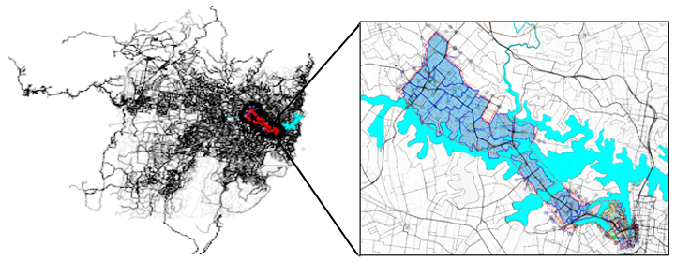
Case Study
We evaluate the proposed demand estimation and prediction models for one of the major subnetworks, the Victoria road corridor.
The initial demand used in this study was obtained from the Sydney Transport Model (STM).
The spatial configuration of the large-scale Sydney transport network and Victoria corridor are presented

Slide 9
Required transport data
Traffic count: SCATS (arterials) traffic counts,
Public transport plans – using GTFS data,
Signal control plans –using SCATS signal timing,
Travellers demand: Origin-destination of private vehicle users,
Incident data logs: includes the incident location ([x,y] coordinates),
….

Slide 10
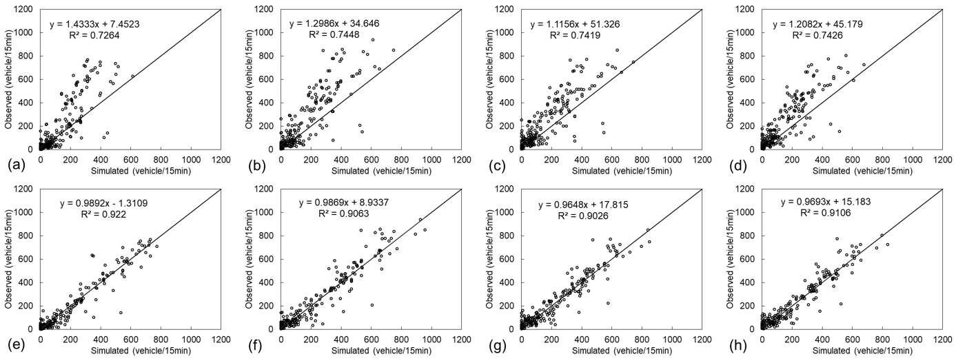
TDOD Estimation Results
Simulated versus observed traffic volumes in four consecutive one-hour interval; before OD estimation implementation (a) 6:00–7:00 am, (b) 7:00–8:00 am, (c) 8:00–9:00 am, and (d) 9:00–10:00 am. After OD estimation implementation (e) 6:00–7:00 am, (f) 7:00–8:00 am, (g) 8:00–9:00 am, and (h) 9:00–10:00 am.

Slide 11
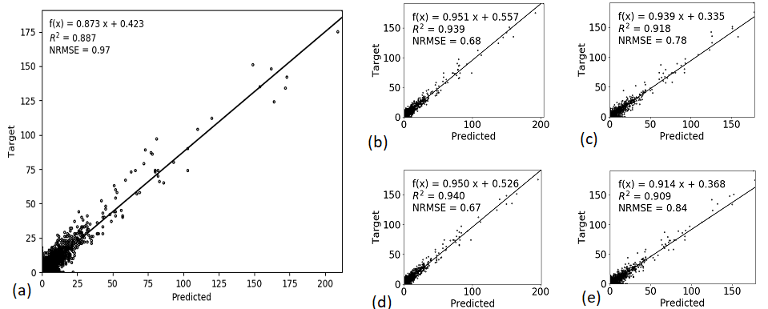
TDOD Prediction Model
Validation of demand forecasting models: (a) no model, ARIMA (b) (1,0,0), (c) (1,1,0), (d) (0,0,1), (e) (0,1,1).

Slide 12
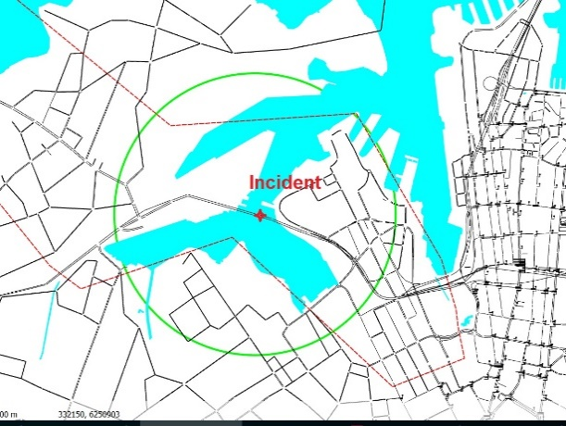
Incident Management Application
we employ the proposed OD demand estimation and prediction for an incident analysis application.
We considered a reported incident on the Anzac Bridge towards the Sydney central business district (CBD).
Two lanes have been affected by the incident which took place at 09:57 AM. The incident information (location and the number of lanes affected) are transferred to the simulation.
The demand prediction module is triggered to forecast the demand starting from 10:00 AM for the next half hour.
The configuration of the incident area, Anzac Bridge, Sydney.

Slide 13
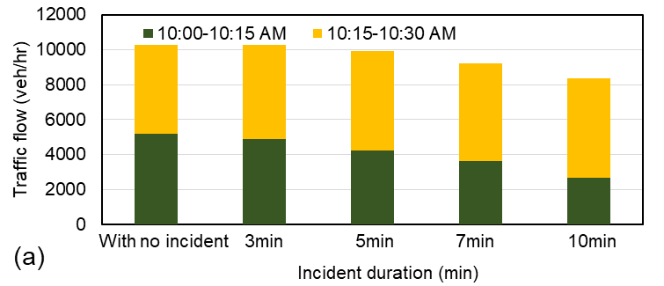
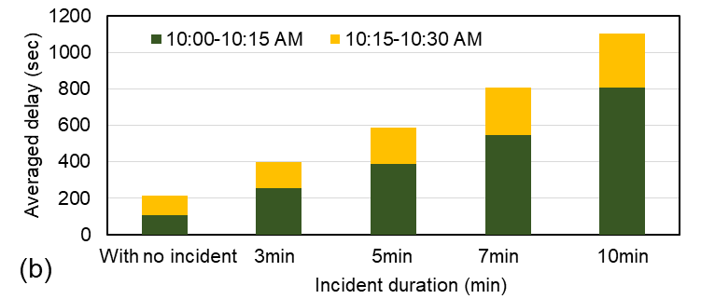
Impact of Incident duration on traffic
The figures present the impact of an incident duration on the traffic flows and network delay.
We basically simulated what would be the impact on the traffic flow if the incident would last for 3 minutes, 5 minutes, 7 minutes and 10 minutes.
(a) Traffic flow passing through the bridge (b) Averaged delay for travellers in the area.
Notes:
Figure 6 shows that a short incident duration (less than 5 minutes) have not significantly reduced the link performance in the next 30 minutes time-interval. However, if the incident would last more than 7 or even 10 minutes, the impact on the flow is significantly higher (which is reducing from almost 10,000 to 8,000 veh/hr – a 20% reduction in the traffic flow in the morning peak hours). That means that severe bottleneck will appear in the upper stream of the network and the impact on the network will be more sever and it will take a longer time before the traffic will re-establish to a normal condition.
Figure 6 showcases once again the average delay on the network which re-iterates the previous finding: every 3 minutes increase in the total duration of an incident would lead in time to an almost exponential increase of the experienced network delay. For example, an incident of 10 minutes would produce an average delay which is almost 5 times higher than if the network wouldn’t experience any incident at all. The finding showcases the power of the proposed approach and the benefits that it brings to traffic management centres for which every minute in in the incident clearance is extremely importance. By coupling together OD prediction and microsimulation models one can accurately estimate the total impact of real accidents and their effect on the network.

Slide 14
Conclusion
This study proposed an efficient OD estimation and prediction approach to reinforce a simulation-based DTA model for operational and planning applications.
The proposed approach initially calibrates the DTA model based on the most updated archived traffic data and then use it for demand prediction for the next time interval.
A bi-level dynamic OD demand estimation problem was formulated and solved iteratively.
The performance of the model was also investigated for the short-term OD prediction. Results show the high capability of the proposed dynamic OD demand estimation to improve the goodness of fit.
An application of the well-calibrated model (R2 =0.93) is presented to show the applicability of the model for daily network operation purposes under incident circumstances.

Slide 15
THANK YOU!

